Slide 1



Predicting the Popularity of MMORPG Games on Steam
Michael Ariyanto
1706043235

Slide 2

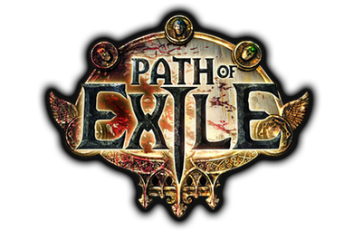
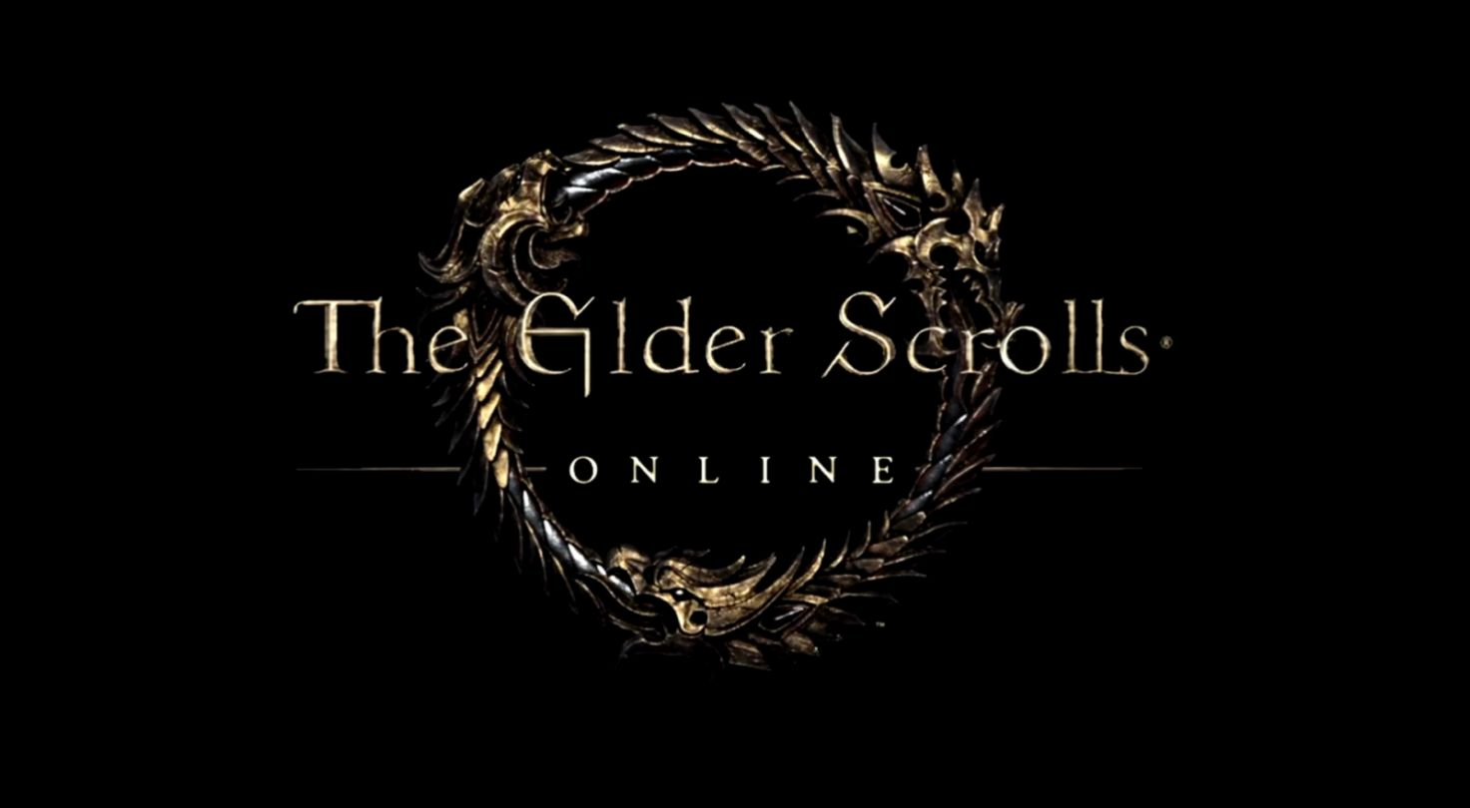
Games Chosen

Slide 3

Final Fantasy XIV: Realm Reborn
Final Fantasy XIV: Realm Reborn is a Massively Multiplayer Online Role-Playing Game (MMORPG) developed and published by Square Enix. Final Fantasy XIV: Realm Reborn is the replacement for the original Final Fantasy XIV as it was shutdown because of negative reception. Final Fantasy XIV: Realm Reborn was released worldwide for Microsoft Windows and Playstation 3 in August 2013 and reach Steam platform in February 2014. Final Fantasy XIV: Realm Reborn was given Best MMO of the year in 2017 by MMORPG, Golden Joystick Awards in 2018, Best of E3 in 2019 by GameSpot, and many more.
- Adventure awaits you beyond the horizon -

Slide 4

Path of Exile
Path of Exile is a free to play Massively Multiplayer Online Role-Playing Game (MMORPG) developed and published by Grinding Gear Games. Path of Exile was released in October 2013 for Steam platform, August 2017 for Xbox One, and March 2019 for Playstation 4. Path of Exile was nominated as a finalist in Game of the Year in Steam Awards 2018 and nominated for the “Labour of Love” Award in Steam Awards 2018.

Slide 5
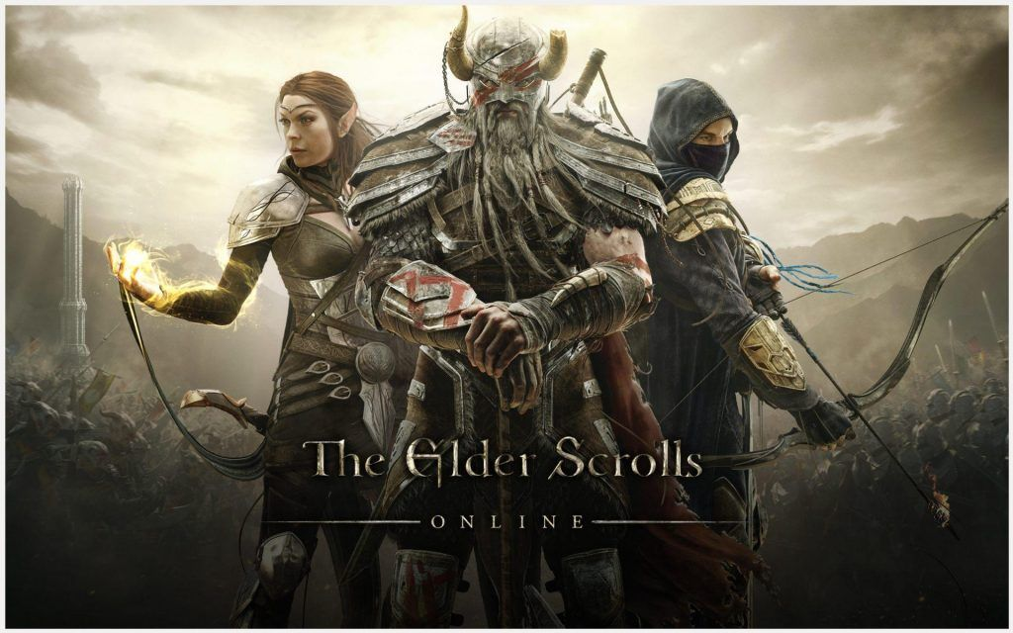
The Elder Scrolls Online
Elder Scroll Online is a Massively Multiplayer Online Role-Playing Game (MMORPG) developed by ZeniMax Online Studios and published by Bethesda Softworks. Elder Scrolls Online was released in April 2014 for Microsoft Windows, Steam platform, and OS X. Elder Scrolls Online are indirectly connected with the other games in the Elder Scrolls franchise.

Slide 6
Analysis
The data from the 3 games chosen will be analyzed and will be used to predict the future Player Count.
The Player Count prediction will be used to predict the popularity of the game.

Slide 7

fbprophet
Prophet is a procedure for forecasting time series data based on an additive model where non-linear trends are fit with yearly, weekly, and daily seasonality, plus holiday effects. It works best with time series that have strong seasonal effects and several seasons of historical data. Prophet is robust to missing data and shifts in the trend, and typically handles outliers well.

Slide 8

How fbprophet works
The Prophet uses a decomposable time series model with three main model components, which is
Trend
Seasonality
holidays
Using time as a regressor, Prophet is trying to fit several linear and non-linear functions of time as components.

Slide 9

How fbprophet works
The 3 main components are combined to make the following equation:
Y(t) = g(t) + s(t) + h(t) + εt
Where:
g(t): piecewise linear or logistic growth curve for modeling non-periodic changes in time series
s(t): periodic changes (e.g. weekly/yearly seasonality)
h(t): effects of holidays (user provided) with irregular schedules
εt: error term accounts for any unusual changes not accommodated by the model

Slide 10

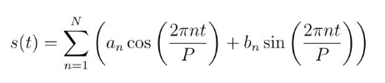
Seasonality
To fit and forecast the effects of seasonality, prophet relies on fourier series to provide a flexible model. Seasonal effects s(t) are approximated by the following function:

Slide 11
Holidays and Events
fbprophet have a built-in collection of country-specific holidays which affecting the data when we are trying to predict the future.
fbprophet also provides a custom list of past and future events that user can modify since holidays and events incur predictable shocks to a time series.

Slide 12
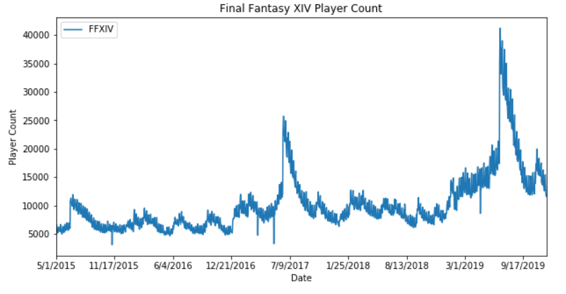
Data Analysis Final Fantasy XIV: Realm Reborn
From the data presented, we can see that the player count of Final Fantasy XIV: Realm Reborn is always stable and only spike in June 2015, June 2017 and July 2019. The sudden increasing of players is caused by a new expansion for Final Fantasy XIV: Realm Reborn. In June 2015, the first expansion, Heavensward, was released. In June 2017, the second expansion, Stormblood, was released. In July 2019, the third and the most anticipated expansion, Shadowbringers, was released. We can also conclude that holidays does not affect the game a lot as it has a loyal player base, especially the fan of Final Fantasy Series.

Slide 13
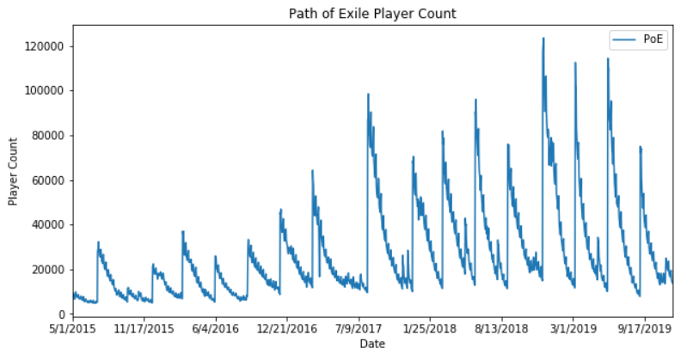
Data Analysis Path of Exile
From the data presented, we can see that the player count of Path of Exile always spike 3-4 times a year. This spike happens since Path of Exile is a free to play game which means its only affected by holidays season. Up until now, Path of Exile does not have a major and game changing updates.

Slide 14
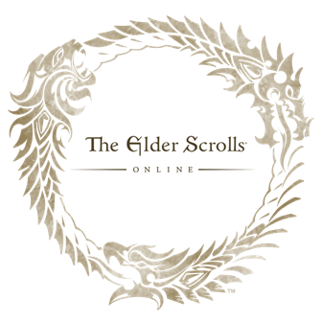
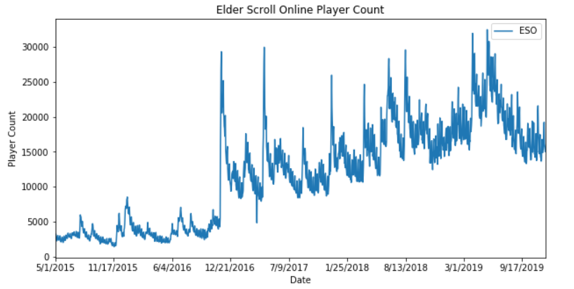
Data Analysis Elder Scrolls Online
From the data presented, we can see that the player count of Elder Scroll Online is spiking a lot. This big increasing of players is caused by the Free Week Madness event which make the game free to play for a week. This Free Week Madness increase its player base by giving players a taste of the game (like free demo) to experience the game before they buy it. After the Free Week Madness, its player count always decrease because there are players that only want to play when its free.

Slide 15
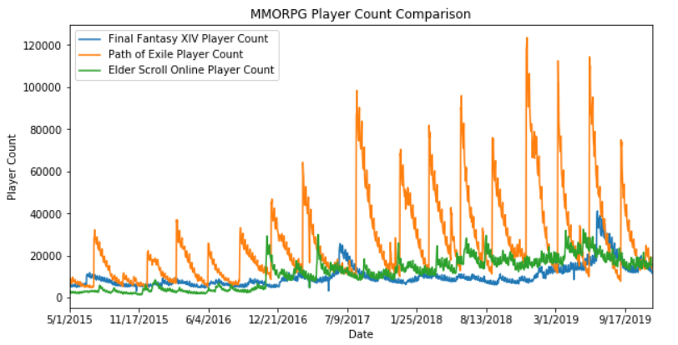
Data Analysis Comparison
From the data presented, we can conclude that, other than the updates and expansion, its player count always increasing every holidays season as the data spike 3 or 4 times every year.

Slide 16
Data Analysis Player Stealing ? Or live in harmony ?
From the data presented, as one game increasing in player count, the other game also have an increase of player. This means that the 3 games does not affect each other in a bad way such as player stealing, but they help each other in terms of player count and popularity of the games. The increase of player in the same time means that MMORPG players might have played multiple games which build a better community for each games.

Slide 17
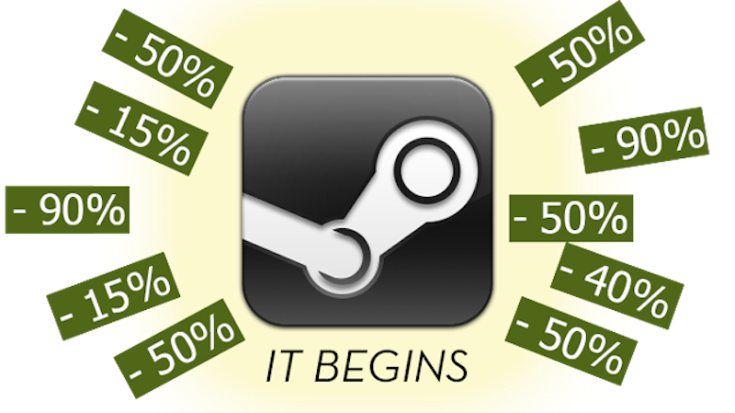
Data Analysis Does Steam Sale Affect the game ?
While Final Fantasy XIV: Realm Reborn and Elder Scrolls Online are affected by Steam Sale, especially Summer Sale and Winter Sale, Path of Exile does not affected by it since Path of Exile is a free to play game. This Steam Sale usually increase the players of a game, but since Steam Sale happens in holidays season, it increases every game player count.

Slide 18

Prediction
Prediction is done by using fbprophet with seasonality, holidays, and events are included into the calculation. The holidays and events which are included:
Summer Sale & Summer Holiday
Winter Sale & Winter Holiday

Slide 19
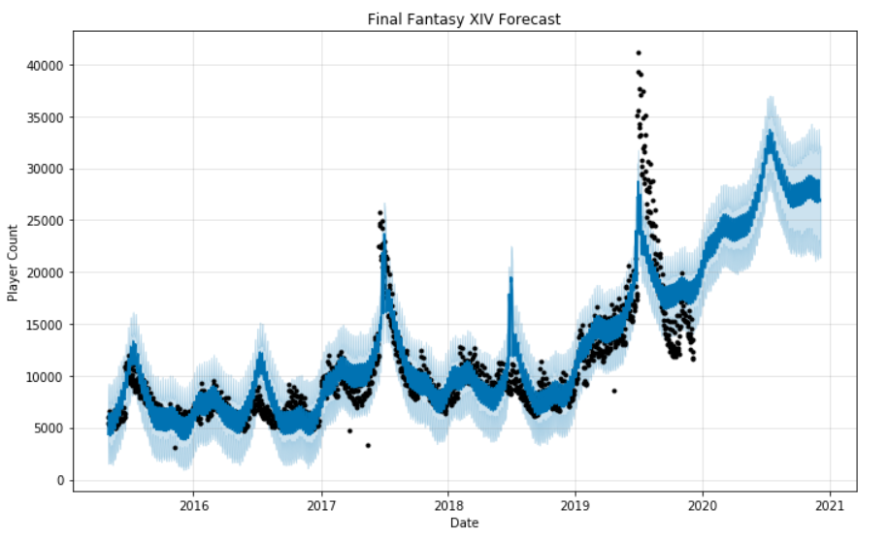
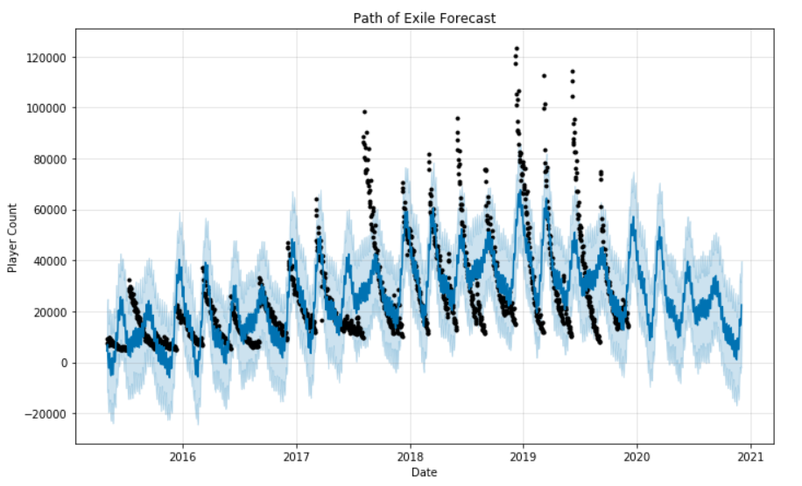
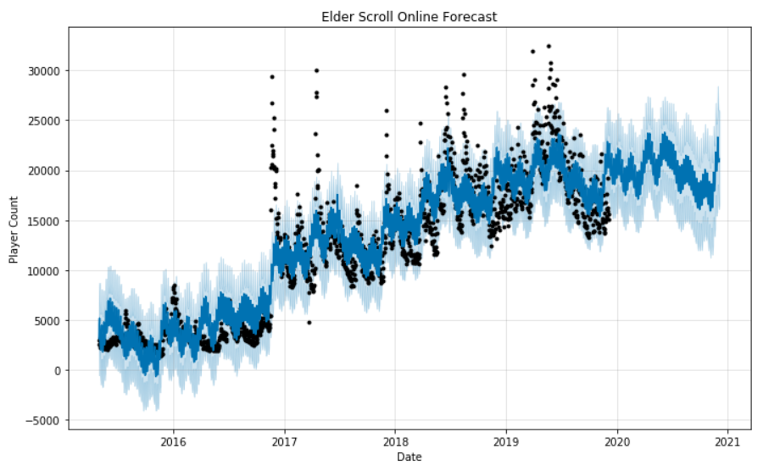
Forecast

Slide 20

Prediction Analysis
From the prediction with fbprophet, we can see and conclude the both Final Fantasy XIV: Realm Reborn and Elder Scrolls Online will have an increase in players, while Path of Exile will have a decrease in players. Final Fantasy XIV: Realm Reborn and Elder Scrolls Online show an increase in players since they both affected greatly by Major Update or Expansion, Steam Sale, and Holidays, while Path of Exile show a decrease in players since its only affected by holidays and there is no major update. This increase and decrease in players also shows the popularity of a game.

Slide 21
Prediction Analysis
This increase and decrease in players also shows the popularity of a game. Final Fantasy XIV: Realm Reborn and Elder Scroll Online are predicted to be more popular than Path of Exile in the future. It also can be seen that Path of Exile player count will not be as much as before in holidays season. If Grinding Gear Games does not give a game changing updates in the future, Path of Exile might go down and disappear from the world of MMORPG Games.

Slide 22

Conclusion
We can conclude that, Final Fantasy XIV: Realm Reborn and Elder Scroll Online will thrive and flourish if they keep their way to give game changing update, events, and discount. While Path of Exile will need to give a game changing update and more events for them to advance forward. Holidays season will also give a big impact in player count of a game and this season are the best time for developers to give events to attract old players to return to the game and new players to dive into the game.

Slide 23
References
https://facebook.github.io/prophet/
https://steamdb.info/app/39210/graphs/
https://steamdb.info/app/238960/
https://steamdb.info/app/306130/graphs/
https://medium.com/tokopedia-data/hacking-time-series-forecasting-like-a-pro-with-fbprophet-76f276f0a058
https://towardsdatascience.com/a-quick-start-of-time-series-forecasting-with-a-practical-example-using-fb-prophet-31c4447a2274

Slide 24
Link
Github
Infographic
https://github.com/MichaelAriyanto/MMORPGonSTEAM
https://www.instagram.com/p/B6I1yTLBuX-/?igshid=6wvb467xevmk

